Slide 1


The Leabra Cognitive Architecture
Randall C. O’Reilly
University of Colorado Boulder
eCortex, Inc.

Slide 2
Key Point
Computational models help us bridge between biological mechanisms and emergent cognitive functions

Slide 3
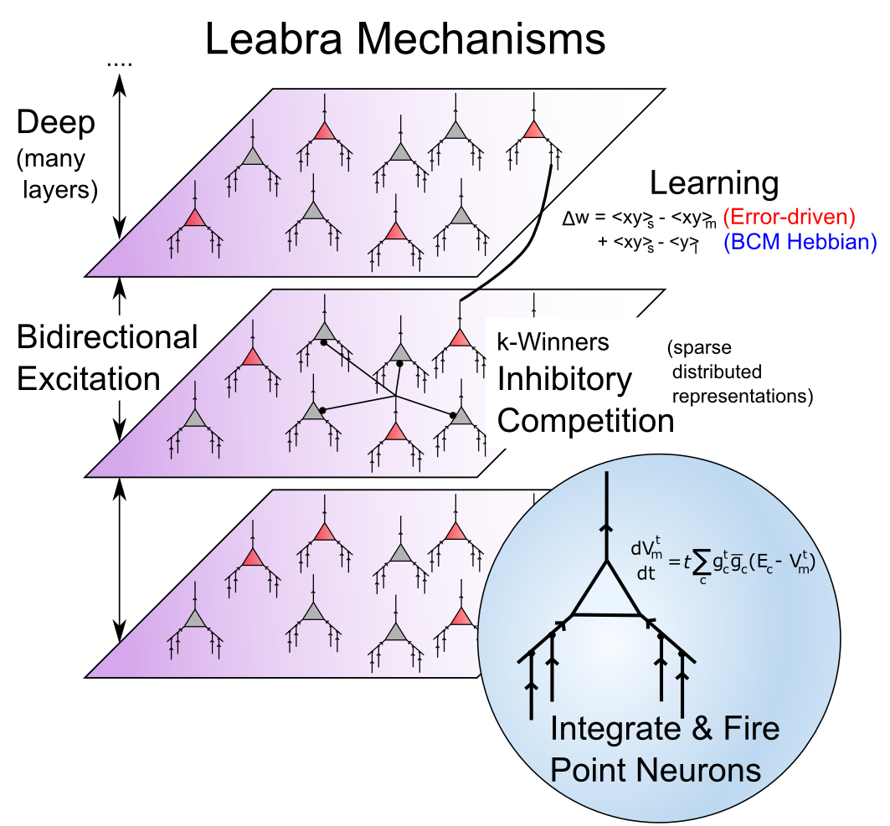
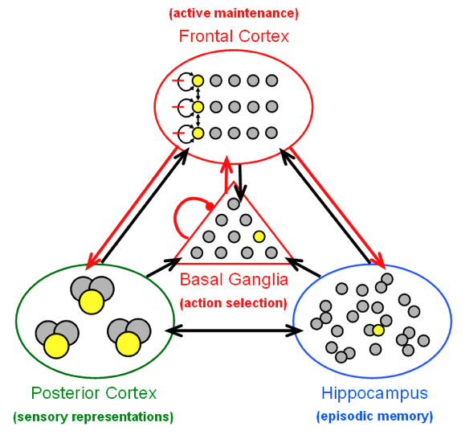
Biological Modeling Framework http://ccnbook.colorado.edu
Same framework accounts for wide range of cognitive neuroscience phenomena: perception, attention, motor control and action selection, learning & memory, language, executive function…

Slide 4
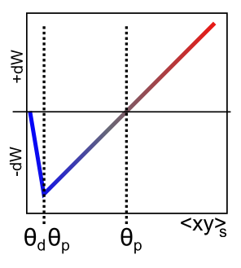
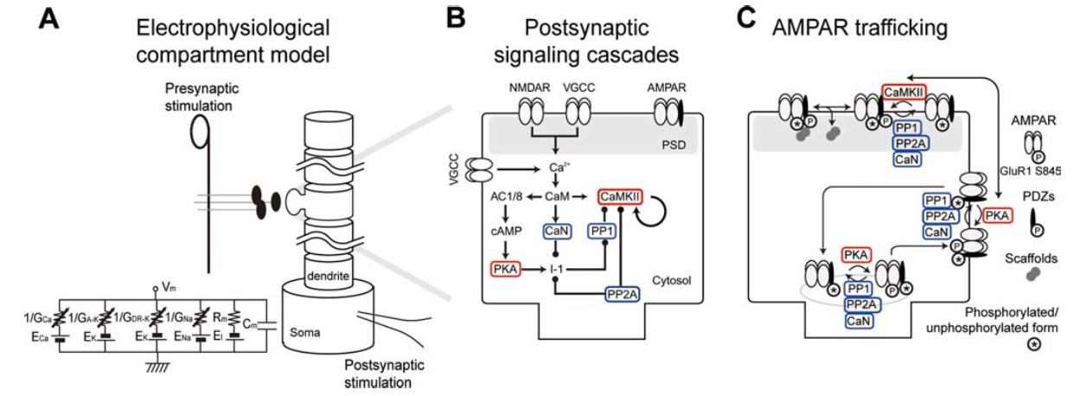
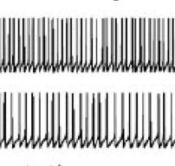
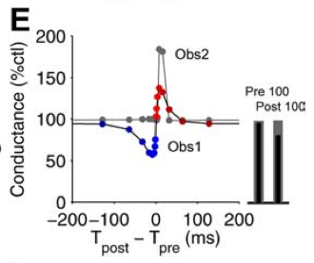
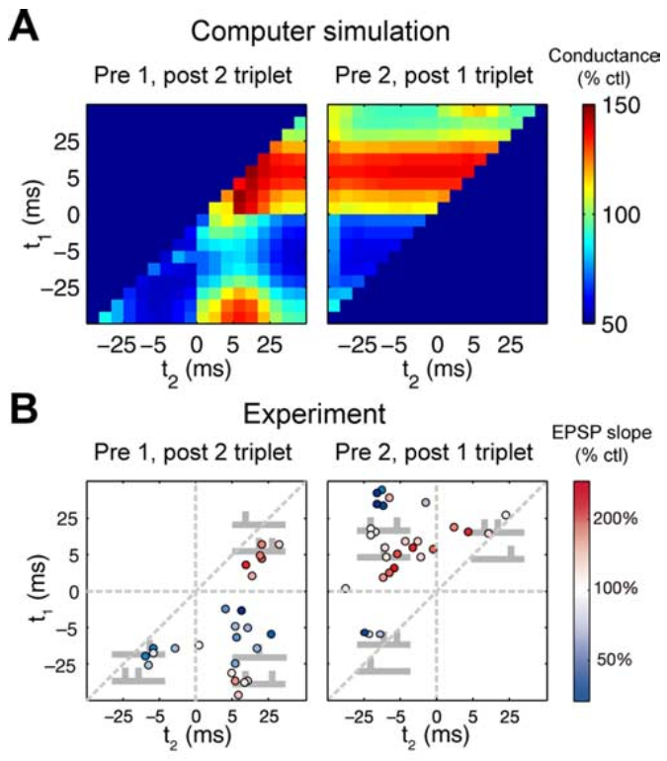
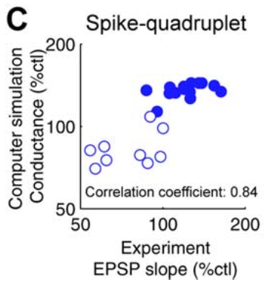
Error-driven Learning from STDP (computational ⬅➔ biological bridge)
Urakubo et al, 2008
Real spike
trains in..
Captures ~80% of variance in model LTP/LTD
(Linearized BCM)
Fits to STDP data for pairs, triplets, quads

Slide 5
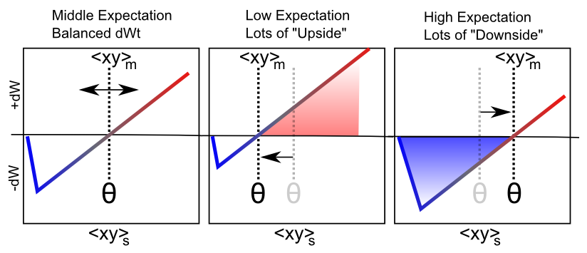
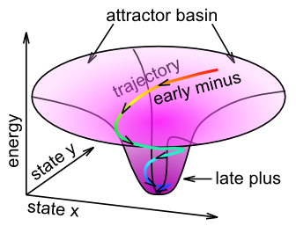
Fast Threshold Adaptation: Outcome vs. Expectation
dW ≈ <xy>_{s} - <xy>_{m}
outcome – expectation
XCAL = temporally eXtended Contrastive Attractor Learning
Notes:
With a linear function, threshold is exactly what is subtracted

Slide 6
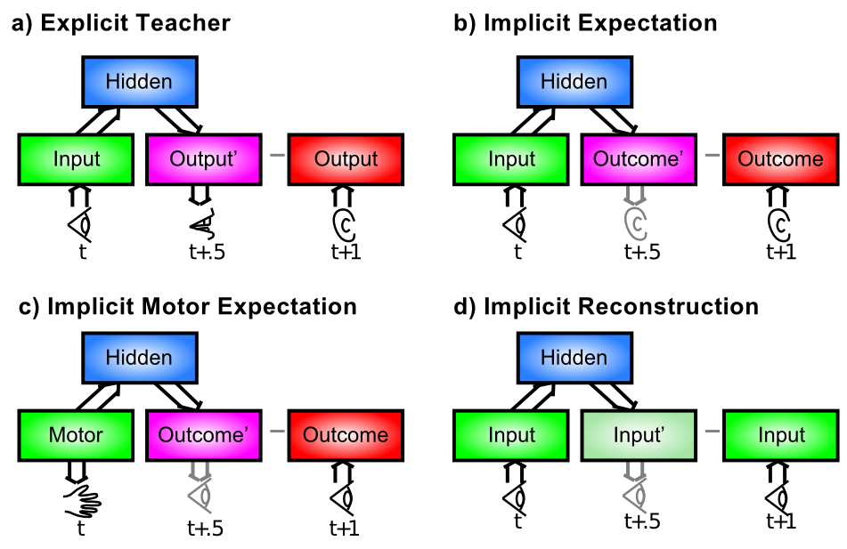
Where Does Error Come From?

Slide 7
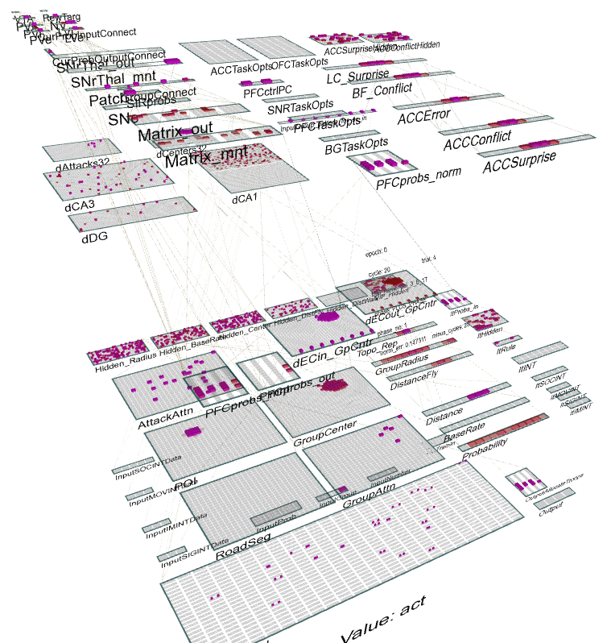
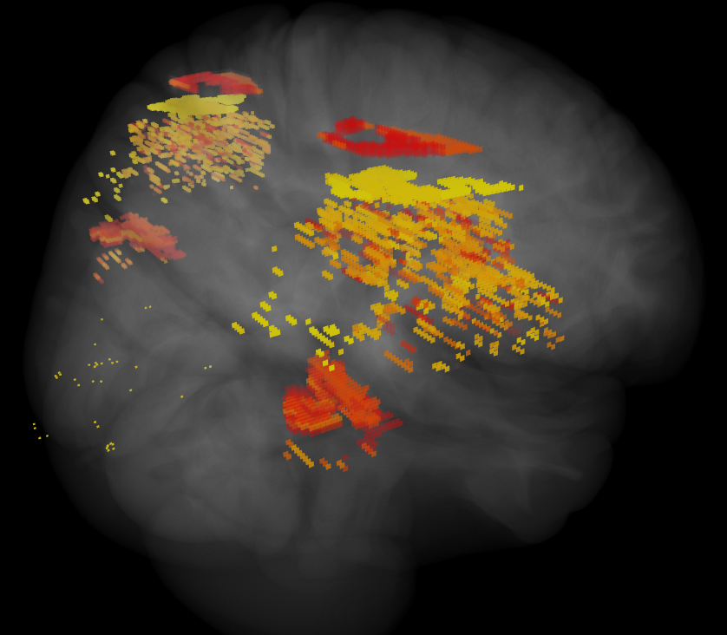
ICArUS-MINDS (IARPA) Integrated Cognitive Architecture for Understanding Sensemaking Mirroring Intelligence in a Neural Description of Sensemaking
Team: HRL (R. Bhattacharyya), CU Boulder (R. O’Reilly), CMU (C. Lebiere), UTH (H. Wang), PARC (P. Pirolli), UCI (J. Krichmar)
Goal: Build biologically-based cognitive architecture to model intelligence analyst.
Brain areas:
Posterior Cortex (IT, Parietal)
PFC/BG/DA
Hippocampus
BNS: LC, ACh

Slide 8
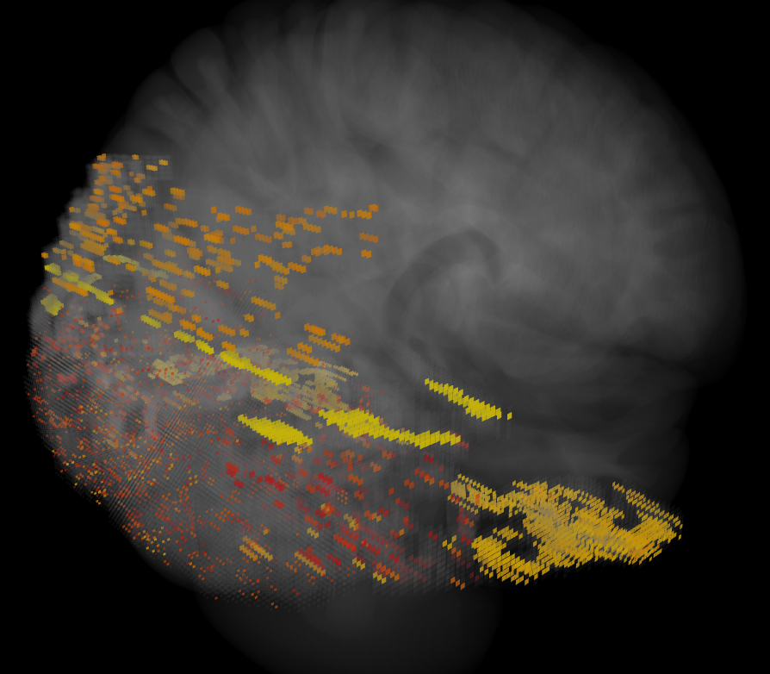
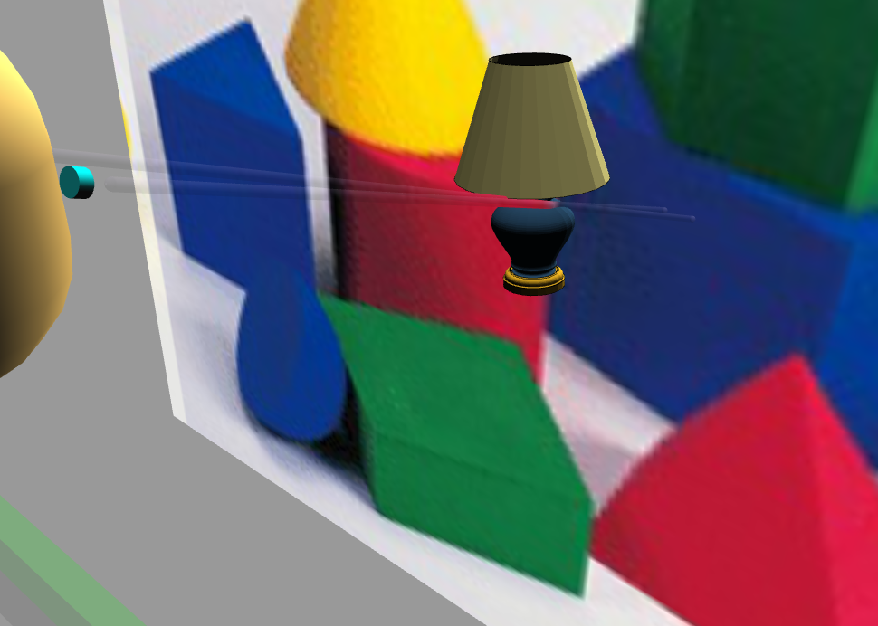
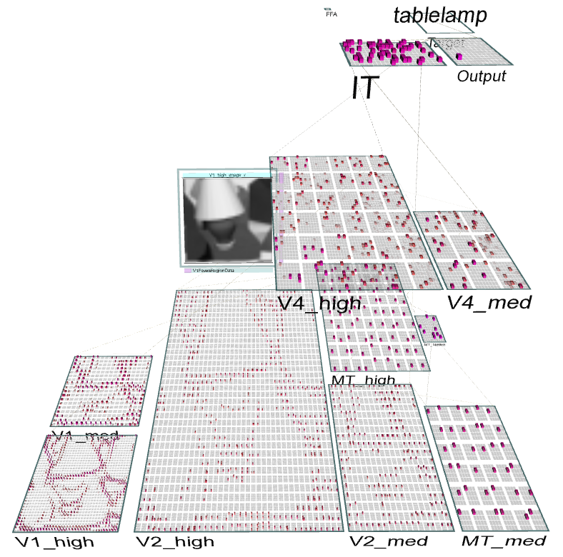
Emer Virtual Robot: Perceptual Motor Control & Robust Object Recognition

Slide 9
Computational Modeling Tradeoffs
Abstract models (e.g., Bayesian):
Pro: simpler, “optimal”, solvable, powerful (SVN, RBM/backprop, etc)
Con: difficulty integrating neuroscience and pervasive learning, too hand-wired and not enough emergence, miss the secret sauce?
Detailed models (e.g., Blue Brain):
Pro: directly integrate detailed neuroscience data, “0 free parameters”
Con: miss critical functional properties in sea of data (e.g., if brain does backprop, would Blue Brain figure this out?)
Middle models (e.g., Leabra):
Pro: directly bridge biology & cognition w/ explicit synergies across levels
Con: not 0 free parameters, nor mathematically derived from first principles (i.e., somewhere in the middle..)

Slide 10
Multilevel Convergent Models (Jilk, Lebiere, O’Reilly & Anderson, 2008)
There is an objective reality.
But it is incredibly complex, with many irreducible levels of emergent phenomena.
So even though there is only one it, there is no one best description of it.
We need multiple convergent levels of description (divergence indicates a problem).

Slide 11
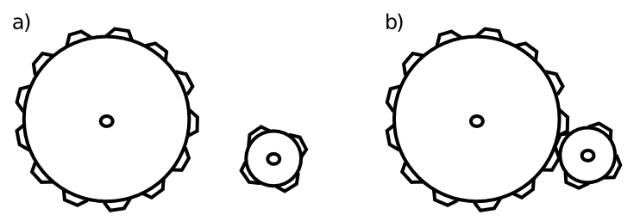
Emergence
Substance does not matter (within broad parameters) – interaction / process is key

Slide 12
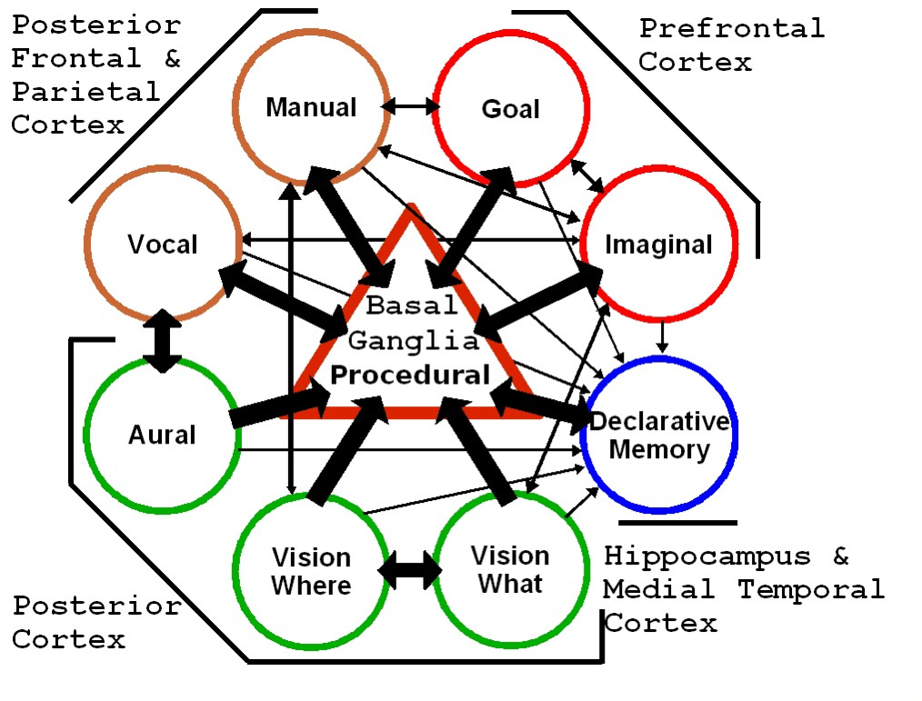
Multilevel Convergent Models (Jilk, Lebiere, O’Reilly & Anderson, 2008)
Leabra
ACT-R
Synthesis of ACT-R and Leabra = SAL

Slide 13
Cognitive Phenomena
Visual encoding: A network views natural scenes (mountains, trees, etc.), and develops brain-like ways of encoding them using principles of learning.
Spatial attention: Taking advantage of interactions between two different streams of visual processing, a model focuses its attention in different locations in space, and simulates normal and brain-damaged people.
Episodic memory: Replicating the structure of the hippocampus, a model forms new episodic memories and solves human memory tasks.
Working memory: A neural network with specialized biological mechanisms simulates our working memory capacities (e.g., the ability to mentally juggle a bunch of numbers while trying to multiply multidigit values).

Slide 14
Cognitive Phenomena
Word reading: A network learns to read and pronounce nearly 3,000 English words, and generalizes to novel nonwords (e.g., “mave” or “nust”) just like people do. Damaging a reading model simulates various forms of dyslexia.
Semantic representation: A network “reads” every paragraph in a textbook, acquiring a surprisingly good semantic understanding by noting which words tend to be used together or in similar contexts.
Task directed behavior: A network simulates the “executive” part of the brain, the prefrontal cortex, which keeps us focused on performing the task at hand and protects us from distraction.

Slide 15
Thanks To
CCN Lab
Tom Hazy
Seth Herd
Tren Huang
Dave Jilk (eCortex)
Nick Ketz
Trent Kriete
Kai Krueger
Brian Mingus
Jessica Mollick
Wolfgang Pauli
Sergio Verduzco-Flores
Dean Wyatte
Funding
ONR – McKenna & Bello
iARPA – Minnery
NSF SLC - TDLC
DARPA - BICA
AFOSR
NIMH P50-MH079485

Slide 16
Extras

Slide 17
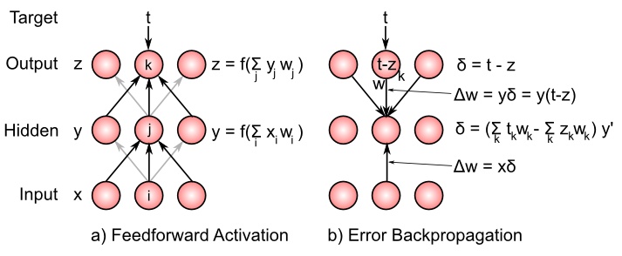
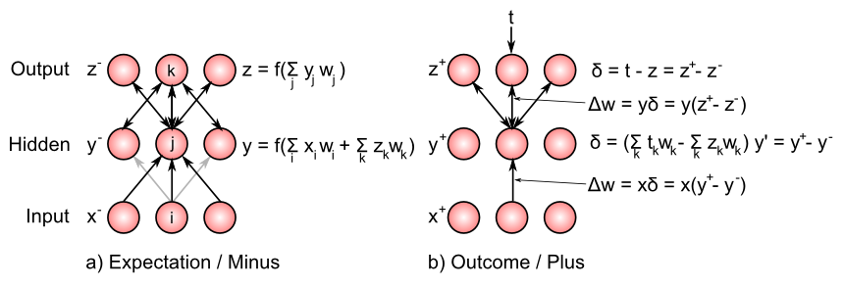
Backpropagation via Activation

Slide 18
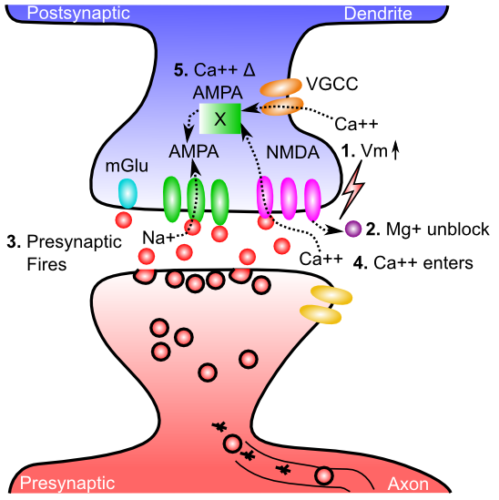
Gettin’ AMPA’d

Slide 19
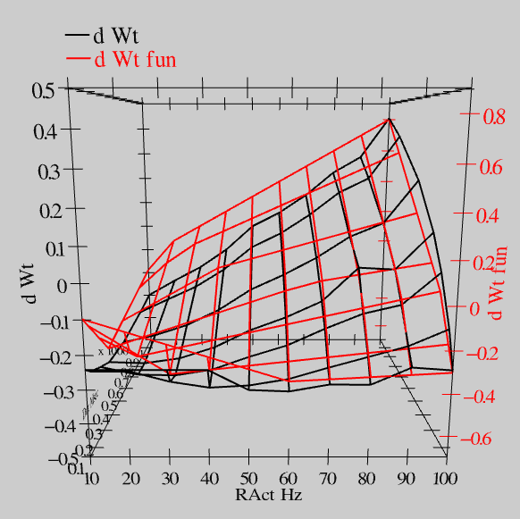
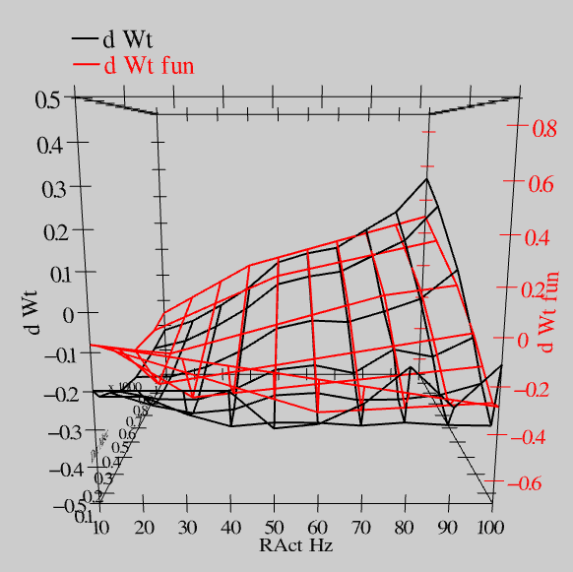
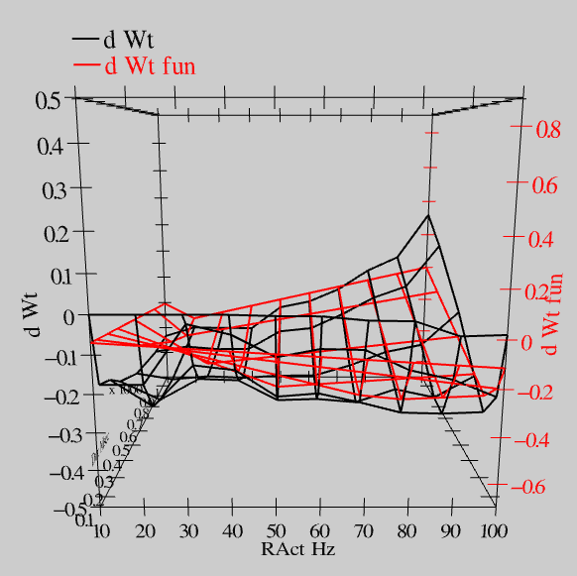
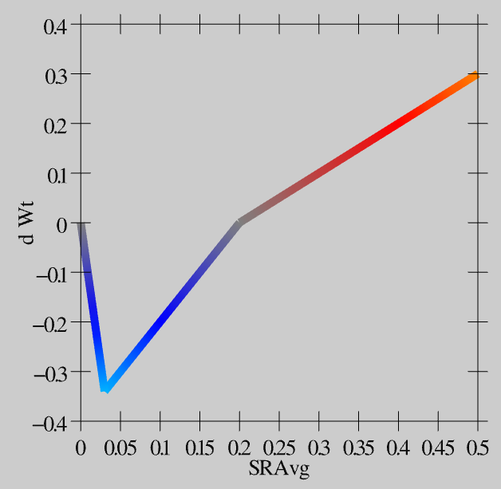
Extended Spike Trains = Emergent Simplicity
S = 100Hz
S = 50Hz
S = 20Hz
dW = f(send * recv) =
(spike rate * duration)
r=.894

Slide 20
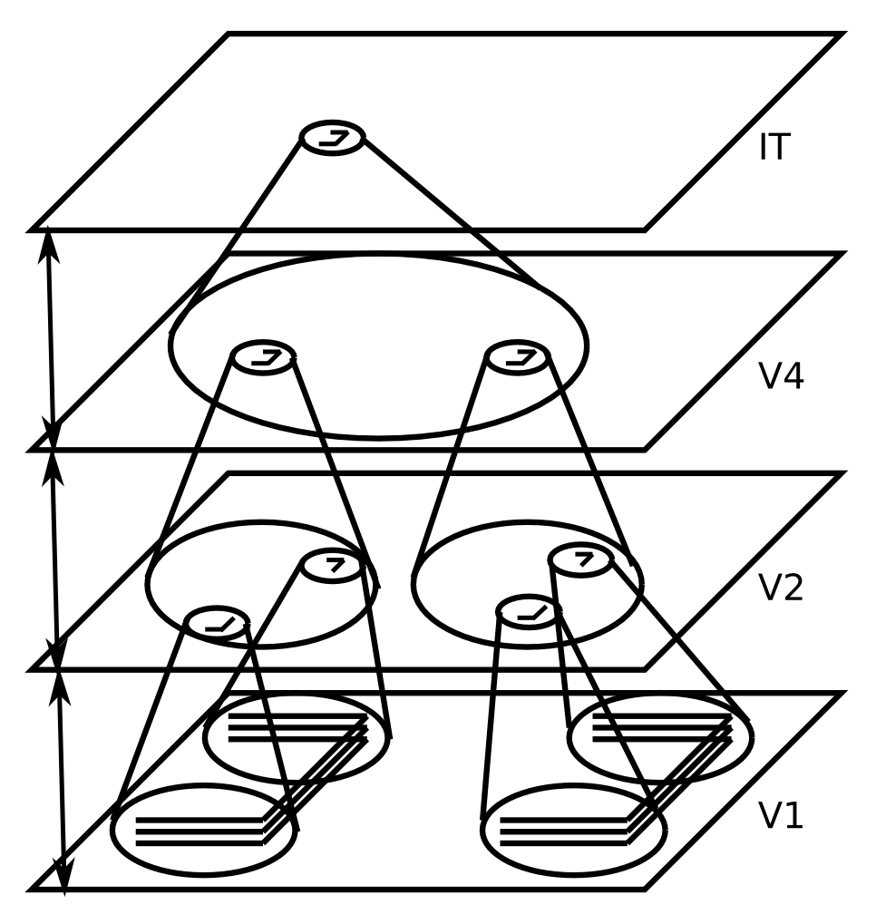
Invariant Object Recognition
Hierarchy of increasing:
Feature complexity
Spatial invariance
Strong match to RF’s in corresponding brain areas
(Fukushima, 1980; Poggio, Riesenhuber, et al…)

Slide 21
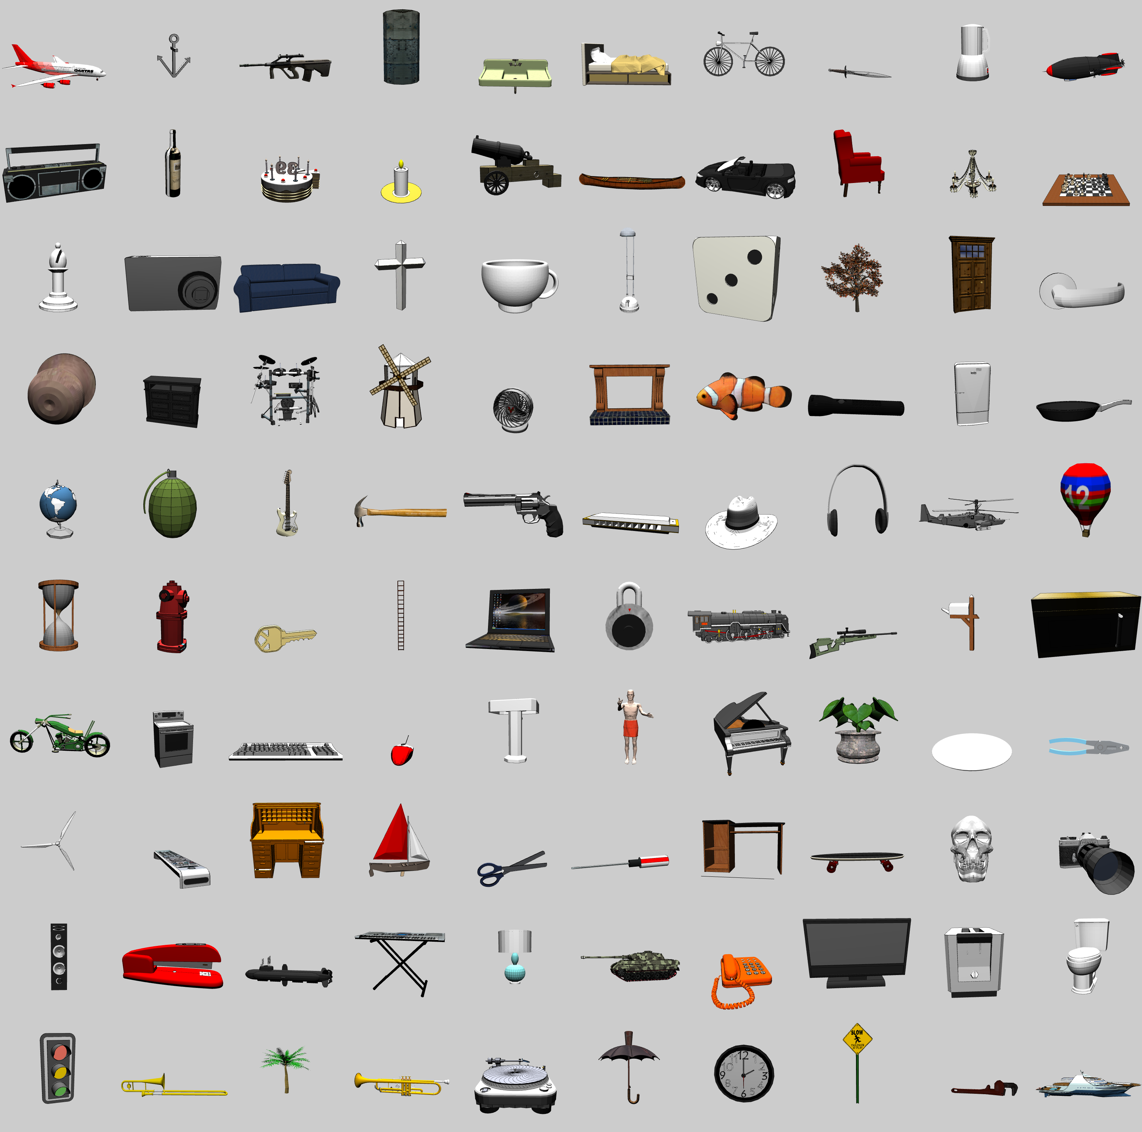
3D Object Recognition Test
From Google SketchUp Warehouse
100 categories
8+ objects per categ
2 objects left out for testing
+/- 20° horiz depth rotation + 180° flip
0-30° vertical depth rotation
14° 2D planar rotations
25% scaling
30% planar translations

Slide 22
Object Recognition Generalization Results

Slide 23
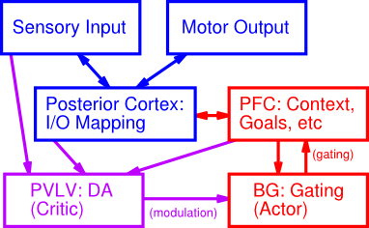
PBWM System

Slide 24
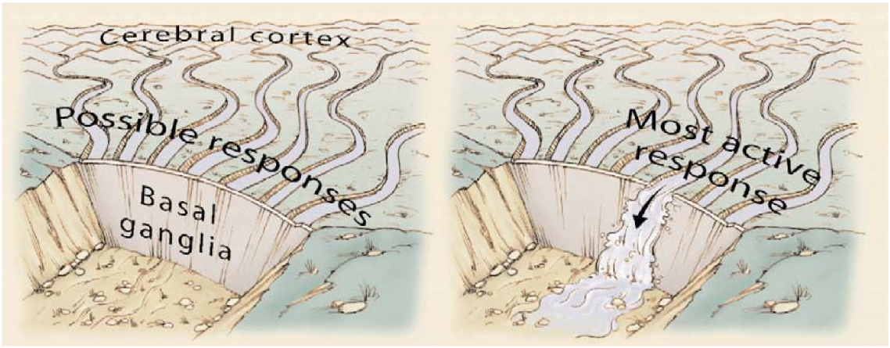
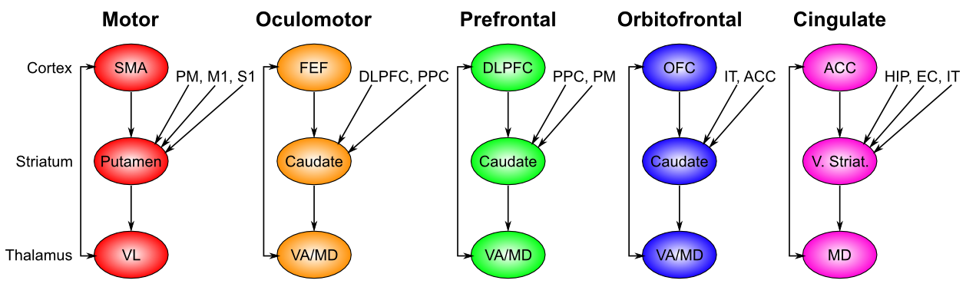
Motor Gating => Cognitive Gating

Slide 25
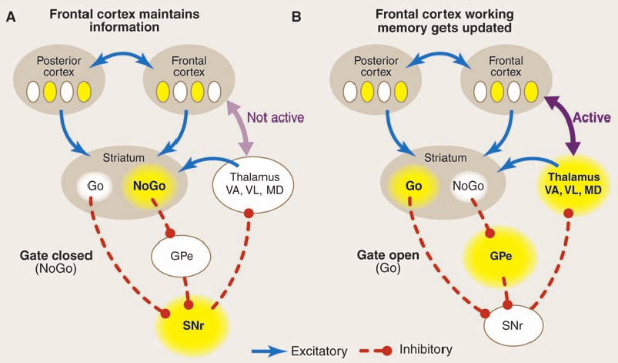
Dynamic, Adaptive Gating (BG)
Toggles PFC bistable states
Resembles transistor logic gate!

Slide 26
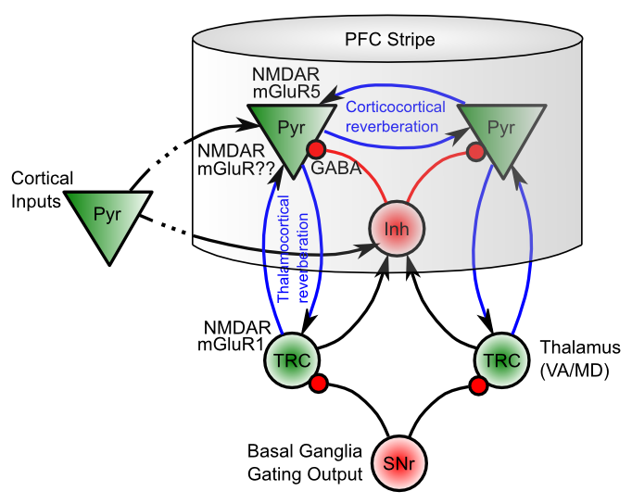
Biological Basis of PBWM

Slide 27
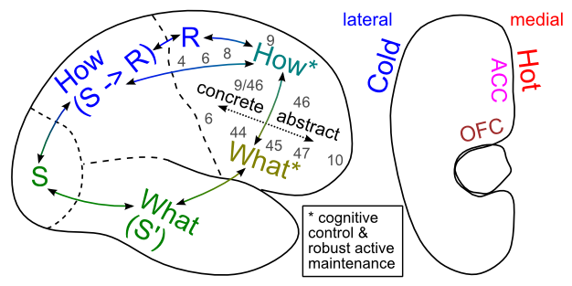
Executive Function

